Slide 1



chapter 3
The Interaction

Slide 2
The Interaction
interaction models
  translations between user and system
ergonomics
  physical characteristics of interaction
interaction styles
  the nature of user/system dialog
interaction design
  stages, usability, software life cycle

Slide 3
What is Interaction?
communication
user  system
but is that all … ?
  see “language and action” …

Slide 4
The Interaction
There are a number of ways in which the user can communicate with the system. These ways categorized into:
  Batch input
  Interactive input
In the batch input, the user provides all the information to the computer at once and leaves the machine to perform the task.
This approach does involve an interaction between the user and computer but does not support many tasks well.

Slide 5
Models of Interaction
terms of interaction
Norman model
interaction framework

Slide 6
Some Terms of Interaction
Traditionally, the purpose of an interactive system is to aid a user in accomplishing goals from some application domain.
Domain
  the area of work under study
  defines an area of expertise and knowledge in some real-world activity.
    e.g. graphic design
Goal
  what you want to achieve
    e.g. create a solid red triangle
Task
  how you go about doing it
  ultimately in terms of operations or actions
    e.g. … select fill tool, click over triangle

Slide 7
Models of Interaction
Interaction involves at least two participants:
  The user
  The system
Both of these two participants are complex and are very different from each other in the way that they communicate and view the domain and the task.
Therefore, there must be an interface which effectively translate between these participants to allow the interaction to be successful.

Slide 8
Models of Interaction
Models of interaction are used to help us:
  to understand exactly what is going on in the interaction and identify the likely root of difficulties.
  to provide us with a framework to compare different interaction styles and to consider interaction problems.

Slide 9
Donald Norman’s model
Norman’s model of interaction is perhaps the most influential in HCI
The user formulates a plan of action, which is then executed at the computer interface.
When the plan, or part of the plan, has been executed, the user observes the computer interface to evaluate the result of the executed plan, and to determine further actions.
The interactive cycle can be divided into two major phases:
  execution
  evaluation

Slide 10
Donald Norman’s model
These can then be subdivided into further stages, seven in all.
The stages in Norman’s model of interaction are as follows:
  user establishes the goal
  formulates intention
  specifies actions at interface
  executes action
  perceives system state
  interprets system state
  evaluates system state with respect to goal
Norman’s model concentrates on user’s view of the interface

Slide 11
Donald Norman’s model
First the user forms a goal.
what the user’s needs to be done - domain and task language.
  It is liable to be imprecise, therefore needs to be translated into the more specific intention.
    intention is a specific action required to meet the goal.
The user perceives the new state of the system, after execution of the action sequence, and interprets it in terms of his expectations.
  If the system state reflects the user’s goal then the computer has done what he wanted and the interaction has been successful.
  otherwise the user must formulate a new goal and repeat the cycle.
Norman uses this model of interaction to demonstrate why some interfaces cause problems to their users.

Slide 12
Execution/Evaluation Loop
goal
    user establishes the goal
    formulates intention
    specifies actions at interface
    executes action
    perceives system state
    interprets system state
    evaluates system state with respect to goal
execution
evaluation
system

Slide 13
Execution/Evaluation Loop
goal
    user establishes the goal
    formulates intention
    specifies actions at interface
    executes action
    perceives system state
    interprets system state
    evaluates system state with respect to goal
execution
evaluation
system

Slide 14
Execution/Evaluation Loop
goal
    user establishes the goal
    formulates intention
    specifies actions at interface
    executes action
    perceives system state
    interprets system state
    evaluates system state with respect to goal
execution
evaluation
system

Slide 15
Execution/Evaluation Loop
goal
    user establishes the goal
    formulates intention
    specifies actions at interface
    executes action
    perceives system state
    interprets system state
    evaluates system state with respect to goal
execution
evaluation
system

Slide 16
Using Norman’s Model
Some systems are harder to use than others
  Gulf of Execution
    user’s formulation of actions
    ≠ actions allowed by the system
  Gulf of Evaluation
    user’s expectation of changed system state
    ≠ actual presentation of this state

Slide 17

Human Error - Slips and Mistakes
slip
  understand system and goal
  correct formulation of action
  incorrect action
mistake
  may not even have right goal!
Fixing things?
  slip – better interface design
  mistake – better understanding of system

Slide 18
Interaction Framework
interaction framework is extension of Norman…
interaction framework attempts a more realistic description of interaction by including the system explicitly.
O
output
S
system(core)
U
user(task)
I
input

Slide 19
Interaction Framework
interaction framework has 4 parts
  user
  input
  system
  output
each has its own unique language
interaction ⇒ translation between languages
problems in interaction = problems in translation

Slide 20
Interaction Framework
When interface sits between the user and the system, there are four steps in the interactive cycle.
  translation from one component to another.
Steps of interactive cycle:
  The user begins the interactive cycle with the formulation of a goal and a task to achieve that goal.
    The only way the user can manipulate the machine is through the input.
  The input language is translated into the core language as operations to be performed by the system.
  The system then transforms itself by the operations.

Slide 21
Interaction Framework
  The system is in a new state, which must now be communicated to the user.
    current values of system attributes are rendered as concepts or features of the output.
  The user should observe the output and assess the results of the interaction relative to the original goal, ending the evaluation phase (the interactive cycle).
See the following figure ( steps of interactive cycle)

Slide 22
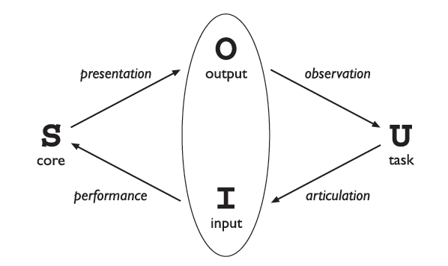
Steps of Interactive Cycle
Translations between interaction components

Slide 23
Frameworks and HCI Related Issues
Frameworks provide a basis for discussing other issues which relate to the interaction.
The ACM SIGCHI Curriculum Development Group presents the interaction framework, and uses it to place different areas which related to HCI.
See the following figure

Slide 24
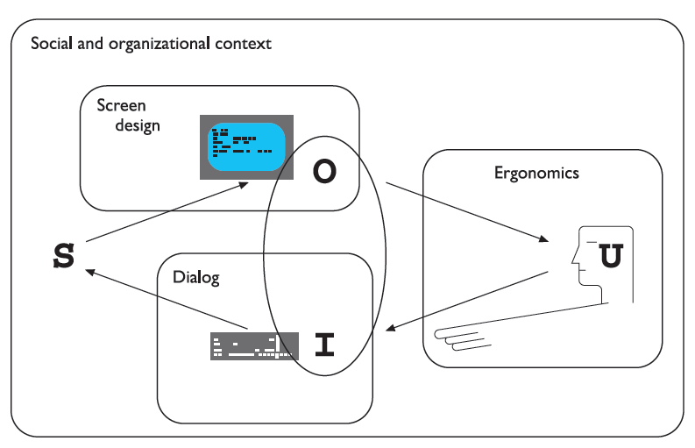
Frameworks and HCI Related Issues
A framework of HCI (Adapted from ACM SIGCHI Curriculum Development Group)

Slide 25
Frameworks and HCI Related Issues
The figure presents the social and organizational context, dialog, ergonomics, and screen design as the areas which related to the interaction.
Each of these areas has important implications for the design of interactive systems and the performance of the user.
  The entire framework can be placed within a social and organizational context that also affects the interaction.
  field of ergonomics addresses issues on the user side of the interface (input, output, context).
  Dialog design and interface styles (relates to the output ) can be placed addressing both articulation and performance.
  Presentation and screen design relates to the output branch of the framework.

Slide 26
Ergonomics
Ergonomics (or human factors) is study of the physical characteristics of interaction
  how the controls are designed
  physical environment in which the interaction takes place
  layout
  physical qualities of the screen
Ergonomics is a huge area, which is distinct from HCI but sits alongside it.
Its contribution to HCI - Ergonomics good at defining standards and guidelines for constraining the way we design systems.

Slide 27
Ergonomics -
Examples
controls are designed and displays
  e.g. controls grouped according to function or frequency of use
surrounding environment
  e.g. seating arrangements adaptable to cope with all sizes of user
health issues
  e.g. physical position, environmental conditions (temperature, humidity), lighting, noise
use of colour
  e.g. use of red for warning, green for okay

Slide 28
Interaction Styles
dialogue … computer and user
distinct styles of interaction

Slide 29
Interaction Styles
There are a number of common interface styles which are:
  command line interface
  menus
  natural language
  question/answer and query dialogue
  form-fills and spreadsheets
  WIMP
  point and click
  three–dimensional interfaces

Slide 30
Command Line Interface
CLI is way of expressing instructions to the computer directly.
  function keys, single characters, short abbreviations, whole words, or a combination
  suitable for repetitive tasks
  better for expert users than novices
  offers direct access to system functionality
  command names/abbreviations should be meaningful!
Typical example: the Unix system

Slide 31
Menus
Menus is set of options displayed on the screen.
  Options visible
    easier to use
    names should be meaningful
  Selection by
    numbers, letters, arrow keys, mouse
    combination (e.g. mouse plus accelerators)
  Often options hierarchically grouped
    sensible grouping is needed
  Restricted form of full WIMP system

Slide 32
Natural language
Computer that is able to understand instructions expressed in everyday words! Natural language understanding, both of speech and written input.
Familiar to user.
Natural language is the subject of much interest and research.
Problems
  vague
  ambiguous
  hard to do well!
Solutions
  try to understand a subset
  pick on key words

Slide 33
Query Interfaces
Question and answer dialog
  simple mechanism for providing input to an application in a specific domain.
  The user is asked a series of questions (mainly with yes/no responses, multiple choice, or codes) and so is led through the interaction step by step.
  interaction via series of questions
  suitable for novice users but restricted functionality
  often used in information systems
Query languages (e.g. SQL)
  used to retrieve information from database
  requires understanding of database structure and language syntax, hence requires some expertise

Slide 34
Form-fills
used primarily for data entry but can also be useful in data retrieval applications.
Screen like paper form, with slots to fill in (see the following figure)..
Data put in relevant place
Requires
  good design
  obvious correction facilities

Slide 35
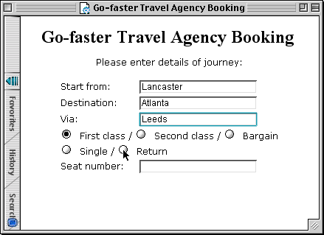
Form-fills
Figure: A typical form Filling Interface

Slide 36
Spreadsheets
The first spreadsheet VISICALC, followed by Lotus 1-2-3.
MS Excel most common today
Sophisticated variation of form-filling.
  grid of cells contain a value or a formula
  formula can involve values of other cells
    e.g. sum of all cells in this column
  user can enter and alter data spreadsheet maintains consistency.

Slide 37
WIMP Interface
WIMP is the default interface style for the majority of interactive computer systems.
  especially PCs and desktop machines
WIMP stands for:
Windows
Icons
Menus
Pointers
… or windows, icons, mice, and pull-down menus!
Examples of WIMP interfaces include ( Microsoft Windows for IBM PC compatibles, MacOS for Apple Macintosh compatibles and various X Windows-based systems for UNIX).

Slide 38
Point and Click Interfaces
Point-and-click interface style is obviously related to the WIMP style.
used in ..
  multimedia
  web browsers
  hypertext
just click something!
  icons, text links or location on map
minimal typing

Slide 39


Three Dimensional Interfaces
There is an increasing use of three-dimensional effects in user interfaces.
The most obvious example is virtual reality.
  but VR is only part of a range of 3D techniques available to the interface designer.
‘ordinary’ window systems
3D workspaces
  use for extra virtual space
  light and occlusion give depth
  distance effects
flat buttons …
click me!
… or sculptured

Slide 40
Elements of The WIMP Interface
windows, icons, menus, pointers
+++
buttons, toolbars,
palettes, dialog boxes

Slide 41
Windows
Windows is areas of the screen that behave as if they were independent
  can contain text or graphics
  can be moved or resized
  can overlap and obscure each other, or can be laid out next to one another (tiled)
scrollbars
  allow the user to move the contents of the window up and down or from side to side
title bars
  describe the name of the window

Slide 42
Icons
Icons is small picture or image
represents some object in the interface
  often a window or action
windows can be closed down (iconised)
  small representation ﬁ many accessible windows
icons can be many and various
  highly stylized
  realistic representations.

Slide 43
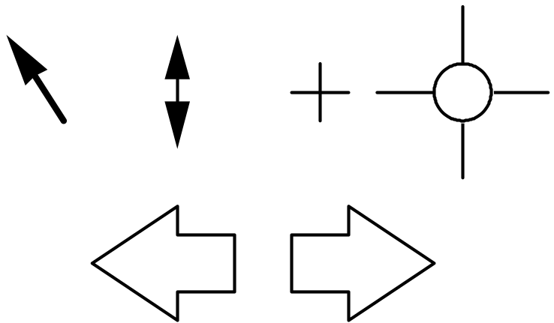
Pointers
important component
  WIMP style relies on pointing and selecting things
uses mouse, trackpad, joystick, trackball, cursor keys or keyboard shortcuts

Slide 44
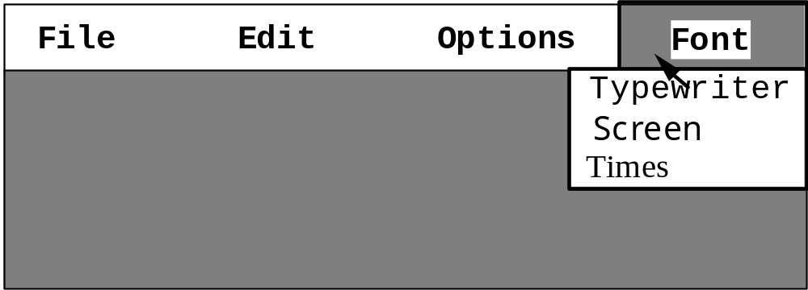
Menus
Choice of operations or services offered on the screen
Required option selected with pointer
problem – take a lot of screen space
solution – pop-up: menu appears when needed

Slide 45
Kinds of Menus
Menu Bar at top of screen (normally)
Menu drags down of screen
  pull-down menu - mouse hold and drag down menu
  drop-down menu - mouse click reveals menu
  fall-down menus - mouse just moves over bar!
Contextual menu appears where you are
  pop-up menus
  pie menus
    easier to select item (larger target area)
    quicker (same distance to any option)
    … but not widely used!

Slide 46
Menus Design Issues
which kind to use
what to include in menus at all
words to use (action or description)
how to group items
choice of keyboard accelerators

Slide 47
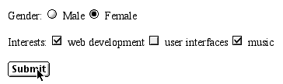
Buttons
Buttons is individual and isolated regions within a display that can be selected to invoke an action
Special kinds
  radio buttons
  – set of mutually exclusive choices
  check boxes
  – set of non-exclusive choices

Slide 48
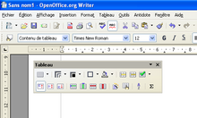
Toolbars
Toolbars is long lines of icons …
… but what do they do?
fast access to common actions
often customizable:
  choose which toolbars to see
  choose what options are on it

Slide 49
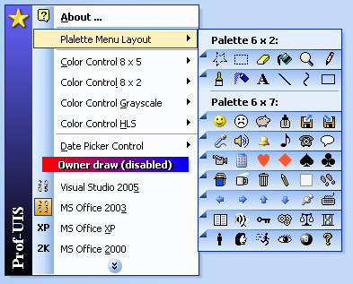
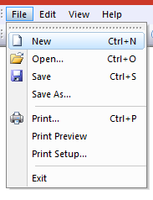
Palettes and tear-off Menus
Problem
menu not there when you want it
Solution
  palettes menus(little windows of actions)
  shown/hidden via menu option
  tear-off and pin-up menus
  menu ‘tears off’ to become palette

Slide 50
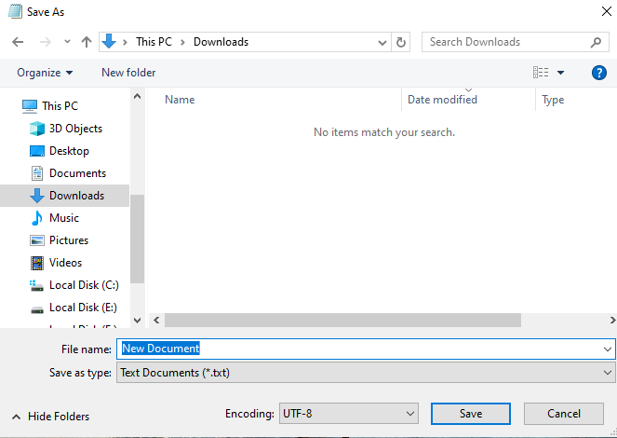
Dialogue Boxes
information windows that pop up to inform of an important event or request information.
  e.g: when saving a file, a dialogue box is displayed to allow the user to specify the filename and location. Once the file is saved, the box disappears.

Slide 51
Interaction Design
stages, usability, software life cycle

Slide 52
Interaction Design
Interaction design is about creating interventions in often complex situations using technology of many kinds including PC software, the web and physical devices.
The design process has several stages and is iterative and never complete.
The design involves:
  Achieving goals within constraints
  Understanding the raw materials
    computer and human
  Accepting limitations of humans and of design.

Slide 53
Interaction Design-
Design Process
Often HCI professionals complain that they are called in too late.
A system has been designed and built, and only when it proves unusable do they think to ask how to do it right!
In other companies usability is seen as equivalent to testing
  checking whether people can use it
  fixing problems
rather than making sure they can from the beginning.
In the best companies, however, usability is designed in from the start.

Slide 54
Interaction Design-
Design Process
Within computer science there is already a large subdiscipline that addresses the management and technical issues of the development of software systems – called software engineering.
One of the cornerstones of software engineering is the software life cycle.
software life cycle is describes the activities that take place from the initial concept formation for a software system up until its eventual phasing out and replacement.

Slide 55
Interaction Design-
Design Process
The important point that we would like to draw out is :
  that issues from HCI affecting the usability of interactive systems are relevant within all the activities of the software life cycle.
Therefore, software engineering for interactive system design is not simply a matter of adding one more activity that slots in nicely
  it involves techniques that span the entire life cycle
See the following figure which shows a simplified view of interaction design process

Slide 56
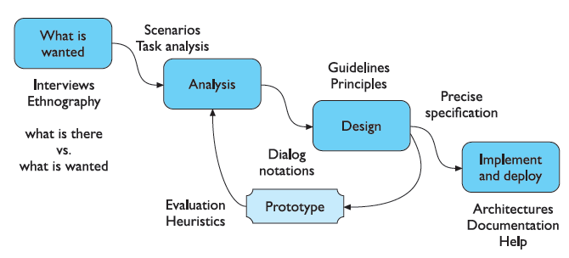
Interaction Design-
Design Process
Figure (Interaction Design Process)

Slide 57



